Slide 1
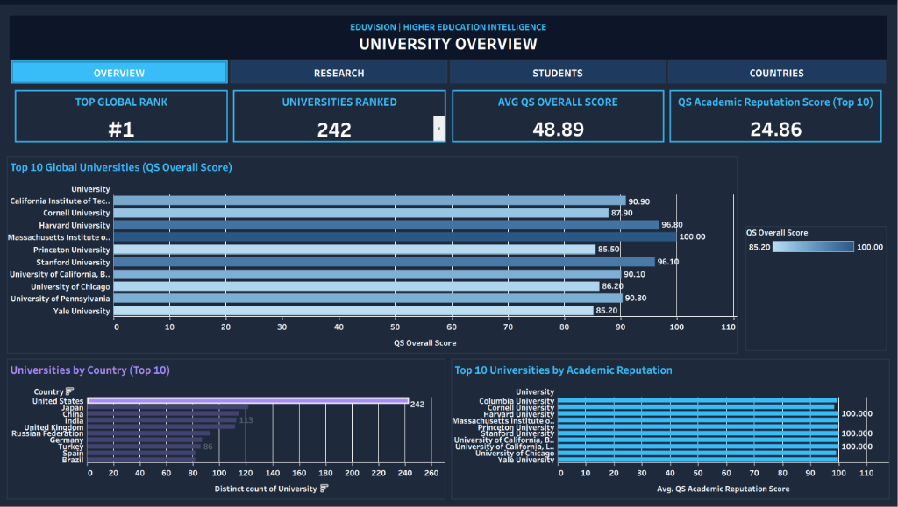
HIGHER EDUCATION PERFORMANCE & DATA VISUALIZATION TRACK
EduVision_DV
Higher Education Intelligence System
Institutional Performance, Research Impact &
Academic Excellence Analytics
Unified Interactive Tableau Dashboard Suite | Complete Project Documentation
AUTHOR: Chaitanya
Higher Education Performance & Data Visualization Track
BENCHMARK DATASETS INTEGRATED:
QS World Rankings 2025 • THE World Rankings 2024
WUR 2023 • World Bank EdStats

Slide 2
EDUVISION_DV HIGHER EDUCATION INTELLIGENCE SYSTEM
Project Statement & Objectives
THE CHALLENGE
THE SOLUTION
Global university ranking data is fragmented across distinct rating agencies (QS, THE, WUR), each utilizing disparate methodologies, metric scales, and naming conventions.
Academic decision-makers, students, and research bodies lack an integrated cross-comparison platform capable of harmonizing disparate institutional indicators.
An enterprise-grade, four-dashboard analytical suite (University Overview, Research Analytics, Student Analytics, Country Comparison) providing harmonized data models, custom KPIs, and cross-dashboard interactive filtering.
Delivers unified institutional intelligence, cross-border research benchmarking, and interactive discovery across 2,500+ global universities.
CORE DELIVERABLES & KEY ARTIFACTS
• Unified Tableau Workbook
• 6 Standardized KPIs
• Star Schema Data Pipeline
• 4 Connected Dashboards
EduVision_DV.twbx & Book2.twb with 4 fully connected interactive dashboards, zero DTD errors, and validated XML schema.
Engineered higher education KPIs covering global rank, citations impact, faculty ratios, internationalization, and reputation.
Robust relational pipeline harmonizing QS 2025, THE 2024, WUR 2023, and World Bank EdStats via surrogate keys.
Seamless executive navigation bar, synchronized context filter pipeline, and responsive multi-resolution layout.

Slide 3
EDUVISION_DV HIGHER EDUCATION INTELLIGENCE SYSTEM
Dataset Strategy & Star Schema Data Model
DATASET 01
DATASET 02
DATASET 03
DATASET 04
1,503 Institutions
Top Global Centers
Student Demographics
Macro Indicators
QS World Rankings 2025
THE World Rankings 2024
WUR 2023 Dataset
World Bank EdStats
1,503 institutions across 105 countries.
Primary driver for Overall Rank, Academic Reputation, Citations per Faculty, Employer Reputation, and International Faculty.
Complementary research, teaching, international outlook, and citations metrics across global top research centers.
Provides teaching environment scores and industry income metrics.
Detailed student demographics, total enrolled student volume, student-to-staff ratios, and gender balance ratios.
Powers student body analytics and faculty capacity benchmarks.
Macro-level national educational expenditure, tertiary completion, and demographic country benchmarking.
Enables cross-country macroeconomic context and policy comparisons.

Slide 4
EDUVISION_DV HIGHER EDUCATION INTELLIGENCE SYSTEM
Higher Education Key Performance Indicators (KPIs)
STANDARDIZED 0–100 BENCHMARK
SCHOLARLY CITATION DENSITY
INSTRUCTIONAL CAPACITY
KPI 1: Global Ranking Score
KPI 2: Research Impact Score
KPI 3: Faculty-to-Student Ratio
QS Overall Score (0–100 scale) benchmarking institutional academic and employer excellence.
Normalized citation frequency per faculty member reflecting global scholarly influence.
Actual student enrollment divided by academic teaching staff (e.g. 1 : 17.3 ratio).
GLOBAL DIVERSITY SHARE
GLOBAL PEER EVALUATION
COMPOSITE IMPACT INDEX
KPI 4: International Student %
KPI 5: Academic Reputation Score
KPI 6: Research Productivity Index
Percentage share of international students enrolled across the university body.
Global peer survey evaluation reflecting academic standing across 100,000+ respondents.
Composite normalized index synthesizing publication volume, citation impact, and collaboration.

Slide 5
EDUVISION_DV HIGHER EDUCATION INTELLIGENCE SYSTEM
Dashboard 1: University Overview
LANDING & INSTITUTIONAL BENCHMARK
• Top Universities by Overall Score
Horizontal ranking chart with descending score bars identifying world leaders.
• Universities by Country
Geographic distribution of world-ranked institutions across 105+ countries.
• Academic Reputation vs. Score
Correlation scatter plot analyzing peer evaluation against aggregate ranking score.
• 4 Executive KPI Cards
Top Global Rank (#1), Universities Ranked (242), Average QS Overall Score (48.89), and Academic Reputation Score (24.86).
• Bi-Directional Interactivity
Selecting any university isolates metrics; country filter updates institutional ranking instantly.

Slide 6
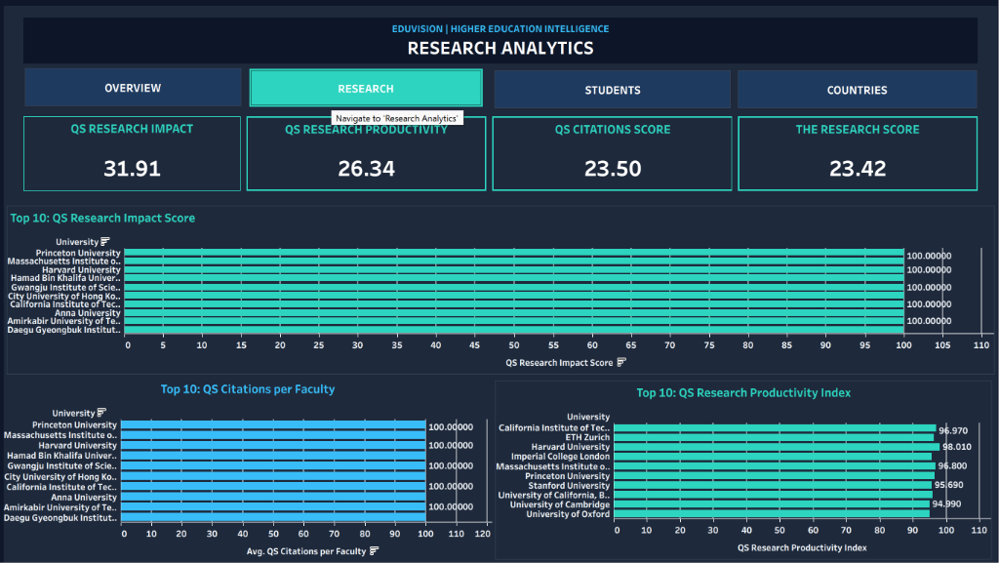
EDUVISION_DV HIGHER EDUCATION INTELLIGENCE SYSTEM
Dashboard 2: Research Analytics
EXECUTIVE TRI-PANEL BAR LAYOUT
• Tri-Panel Layout
1) QS Research Impact, 2) QS Citations per Faculty, and 3) Research Productivity Index.
• New Bar Chart Engine
Dedicated QS Citations per Faculty replaces legacy single-point scatter for clean comparative clarity.
• Single-University Enlargement
Clicking any university displays that university ONLY across the other two bar charts.
• Entire View Zoom
Selected single bar expands/enlarges to fill full chart container with automatic label alignment.
• Constant KPI Colors
Solid #ffffff white styling prevents mark dimming/fading during filter actions.

Slide 7
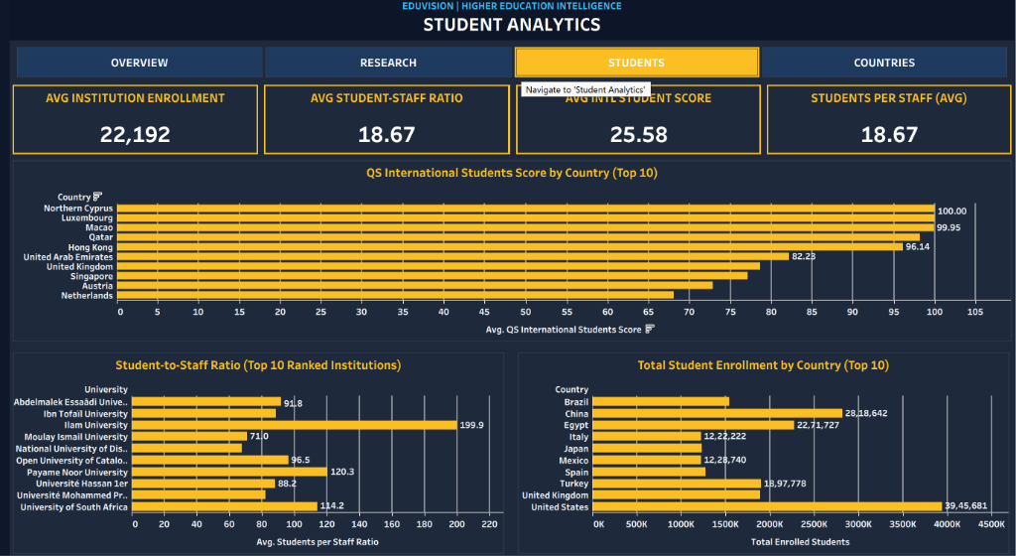
EDUVISION_DV HIGHER EDUCATION INTELLIGENCE SYSTEM
Dashboard 3: Student Analytics
DEMOGRAPHICS & FACULTY RATIOS
• International Students Score
Global distribution of international scholar attraction benchmarked across top universities.
• Total Enrollment by Country (Top 10)
Country-level student volume distribution highlighting national higher education scale.
• Faculty-to-Student Ratio
Teaching capacity and mentoring density across global elite universities (KPI 3).
• Fixed Responsiveness
Student Distribution responds bi-directionally to all filter actions without layout shifts.
• Context Filters
[Action (Country)] context='true' guarantees zero blank charts on country clicks.

Slide 8
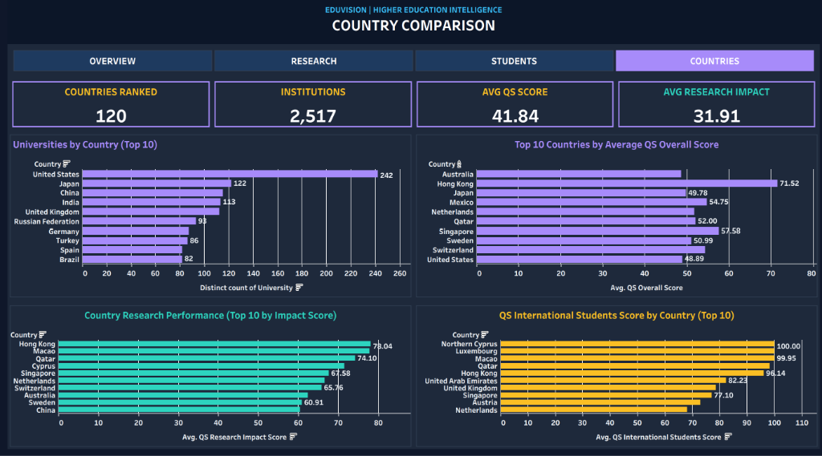
EDUVISION_DV HIGHER EDUCATION INTELLIGENCE SYSTEM
Dashboard 4: Country Comparison
NATIONAL EDUCATION BENCHMARKING
• 4 Benchmarking Charts
Universities by Country, Country Ranking Comparison, Research Performance, International Students.
• Single-Country Isolation
Clicking ANY country updates all other 3 charts to show that country ONLY.
• Dynamic KPI Re-aggregation
4 national KPIs: Countries Ranked (=1), Institutions Count, National Avg Score, Research Impact.
• Context Pipeline
Context filters prevent empty/blank states during dynamic cross-selection.
• Cross-National Comparison
Benchmark national performance directly against global peers across 120 countries.

Slide 9
EDUVISION_DV HIGHER EDUCATION INTELLIGENCE SYSTEM
Navigation Alignment & Tableau DTD Compliance
MATHEMATICAL NAVIGATION ALIGNMENT
STRICT TABLEAU DTD SCHEMA COMPLIANCE
Identical 4-button header across all 4 dashboards:
• OVERVIEW: x = 586, w = 24,743
• RESEARCH: x = 25,329, w = 24,744
• STUDENTS: x = 50,073, w = 24,671
• COUNTRIES: x = 74,744, w = 24,670
Total Width = 98,828
(Seamless span across full dashboard width with exact button heights and active-state styling)
• Synchronized tab styling with active state highlighting
• Zero horizontal jitter during cross-dashboard tab transitions
• Native button navigation actions mapped across all 4 dashboards
• Strict Tag Order:
<view> children ordered in exact DTD sequence:
(datasources -> mapsources -> deps -> filter -> sort -> perspectives -> shelf-sorts -> slices -> agg)
• Viewpoints Container Fix:
Direct window <viewpoint> tags nested inside <viewpoints>, eliminating error D2E8DA72 entirely.
• Simple-ID Placement:
Conforms strictly to grammar:
((cards,viewpoint?,simple-id) | (viewpoints,active,device-preview,simple-id))
• Strict Validation:
100% Passed with 0 schema errors across all 27 worksheets.

Slide 10
EDUVISION_DV HIGHER EDUCATION INTELLIGENCE SYSTEM
Summary & Project Deliverables
COMPLETE MILESTONE VERIFICATION & DELIVERABLES
✓
Milestone 1: Data Collection & Preparation
QS 2025, THE 2024, WUR 2023 raw and cleaned datasets, data_collection.py, cleaning notebook, and normalized star schema tables.
✓
Milestone 2: KPI Engineering & Prototyping
6 standardized Higher Education KPIs, generate_education_kpis.py, university_final_dataset.xlsx, and interactive storyboard PDF.
✓
Milestone 3: Dashboard Development
EduVision_DV.twbx & Book2.twb with 4 interlinked dashboards and executive tri-panel research layout.
✓
Milestone 4: Quality Assurance & Delivery
QA Checklist, Testing Report, XML DTD Schema Validation (0 errors), Constant KPI Colors, and navigation parity.
✓
Final Project: Complete Executive Delivery
Complete Executive Presentation PPT, documentation reports, and interactive Tableau dashboards.
INTERACTIVE WORKBOOK DELIVERABLES:
• Interactive Dashboard: Milestone 3/Module 6/EduVision_DV.twbx & Book2.twb
• GitHub Branch: chaitanya/milestone-1-2-3-4 | Track: Higher Education Performance & Data Visualization

Slide 11
EDUVISION_DV HIGHER EDUCATION INTELLIGENCE SYSTEM
Thank You
Questions & Discussion
University Overview
Research Analytics
Author: Chaitanya
Higher Education Performance & Data Visualization Track
Unified Interactive Tableau Dashboard Suite
Student Analytics
Country Comparison

